Slide 1


SOFTWARE ENGINEERING (Week-10)
Usama Musharaf
Lecturer (Department of Computer Science)
FAST-NUCES Peshawar

Slide 2
Content of Week # 10
Software Testing (cont..)
White Box Testing
Test Document

Slide 3
White box Testing

Slide 4
White box testing / Structural testing
Based on knowledge of internal logic of an application's code
Based on coverage of code statements, branches, paths, conditions.
Tests are logic driven.

Slide 5
Control Flow Testing
Based on the flow of control in the program.
Logical decisions
Loops
Execution paths
Coverage metrics
Measure of how complete the test cases are.

Slide 6
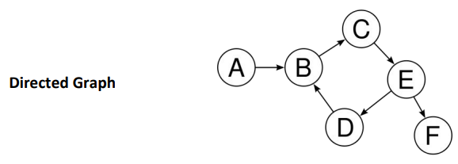
Control Flow Graph
Given a program written in an imperative programming language, its program graph is a directed graph in which nodes are statement fragments, and edges represent flow of control.

Slide 7
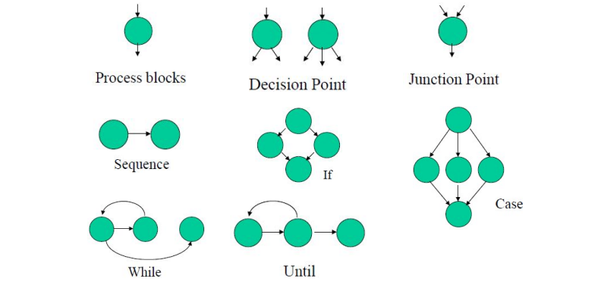
Control Flow Graph

Slide 8
Steps to Draw Control Flow Graph
Number all the statements of a program.
Numbered statements: represent nodes of the control flow graph.
An edge from one node to another node exists: if execution of the statement representing the first node can result in transfer of control to the other node.

Slide 9
Program flow graph Basic Control Flow Graph
class IfStatement {
public static void main(String[] args) {
int number = 10;
if (number > 0) {
System.out.println("The number is positive.");
}
else {
System.out.println("The number is negative.");
}
System.out.println("Statement outside if block");
}
}

Slide 10
Coverage:
Statement Coverage:
In this scheme, statements of the code are tested for a successful test that checks all the statements lying on the path of a successful scenario.
Branch Coverage:
In this scheme, all the possible branches of decision structures are tested. Therefore, sequences of statements following a decision are tested.
Path Coverage:
In path coverage, all possible paths of a program from input instruction to the output instruction are tested. An exhaustive list of test cases is generated and tested against the code.

Slide 11
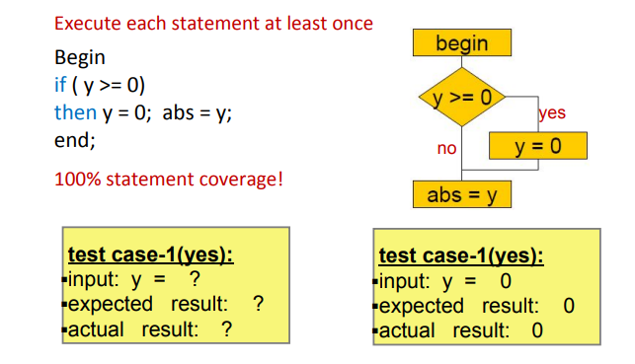
Statement Coverage

Slide 12
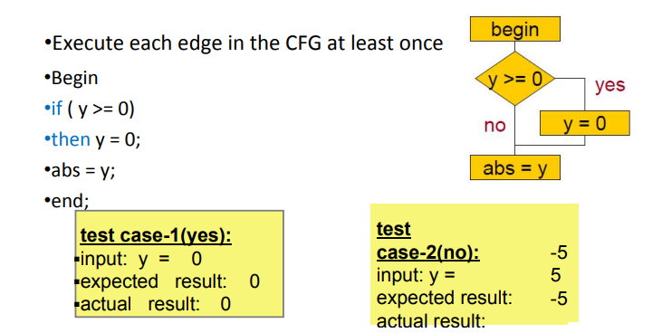
Decision/Branch Coverage
Every statement in the program has been executed at least once, and every decision in the program has taken all possible outcomes at least once.

Slide 13
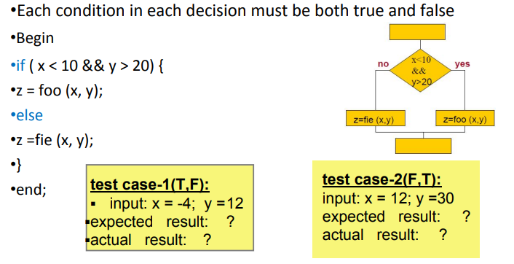
Decision/Condition Coverage

Slide 14
Path coverage
A path is a sequence of branches, or conditions.
A path corresponds to a test case, or a set of inputs.
In code coverage testing, branches have more importance than the blocks they connect.
Bugs are often sensitive to branches and conditions

Slide 15
McCabe’s Complexity Metric
Cyclomatic Complexity is a software metric that provides a Quantitative measure of the logical complexity of a program.

Slide 16
McCabe’s Complexity Metric
The cyclomatic complexity of the program is computed from its control flow graph (CFG) using the formula:
V(G) = Edges – Nodes + 2
or by counting the conditional statements and adding 1
This measure determines the basis set of linearly independent paths and tries to measure the complexity of a program.

Slide 17
Cyclomatic Complexity
V(G) = Edges – Nodes + 2
V(G) = 6 – 6 + 2 = 2
V(G) = conditional statements + 1
= 1 + 1 = 2
Two linearly independent paths:
1, 2, 5, 6
1, 2, 3, 4, 2, 5, 6
Complexity = 2 < 10 => good quality
1
2
3
4
5
6

Slide 18
V(G) = Edges – Nodes + 2
V(G) = 16 – 14 + 2 = 4
V(G) = conditional statements + 1
= 3 + 1 = 4
four linear independent paths
Complexity = 4 < 10 => good quality

Slide 19
Cyclomatic Complexity
V(G) | Risk
1 – 10 | easy program, low risk
11 – 20 | complex program, tolerable risk
21 – 50 | complex program, high risk
>50 | impossible to test, extremely high risk

Slide 20
Applicability and limitation
Control flow testing is the basis of unit testing.
It should be used for all modules of code that cannot be tested sufficiently through reviews and inspections.
Its limitation are that the tester must have sufficient programming skill to understand the code and its control flow
Control flow testing can be very time consuming.

Slide 21
Test Document

Slide 22
Test Document
Testing documentation involves the documentation of artifacts which should be developed before or during the testing.
Documentation for Software testing helps in estimating the testing effort required, test coverage, requirement tracking/tracing etc.
This section includes the description of some commonly used documented artifacts related to Software testing such as:
Test Plan
Test Scenario
Test Case
Traceability Matrix

Slide 23
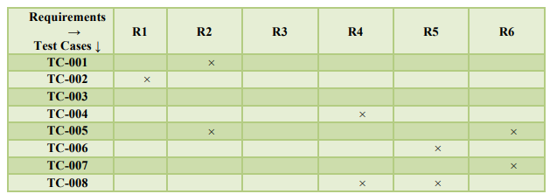
Requirement Traceability

Slide 24
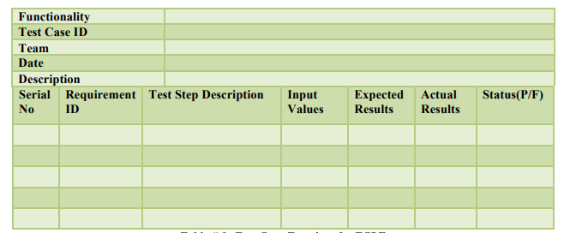
Test Case Template

Slide 25
Test Requirements
Functional Requirements
Non –Functional Requirements
Performance
Scalability
Reliability

Slide 26
Scenarios for NFRs
Scenarios are a technique developed at the SEI to find out issues concerning an architecture through manual evaluation and testing.
Scenarios are related to architectural concerns such as quality attributes, and they aim to highlight the consequences of the architectural decisions that are encapsulated in the design.

Slide 27
Scenario Types
Use case scenarios reflect the normal state or operation of the system.
Growth scenarios are anticipated changes to the system (e.g., double the message traffic, change message format.
Exploratory scenarios are extreme changes to the system. These changes are not necessarily anticipated or even desirable situations (e.g., message traffic grows 100 times, replace the operating system).

Slide 28
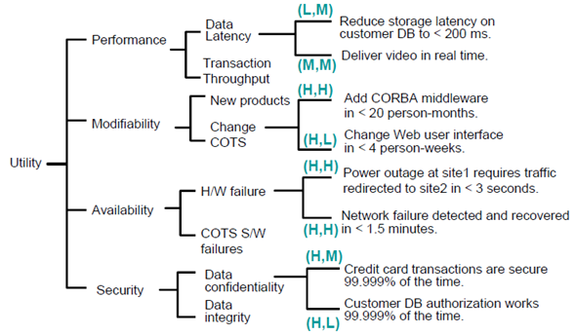
Utility Tree Example

Slide 29
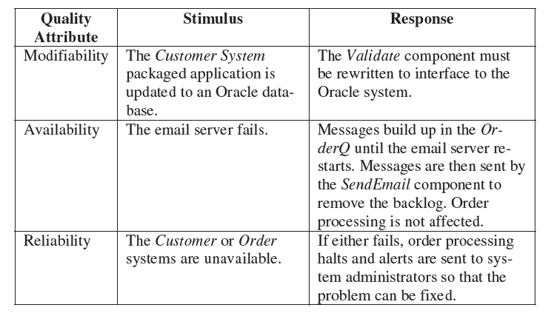
Utility Tree Example

Slide 30
HAVE A GOOD DAY!

